Slide 1
Employers who are Covered by FTA and FMCSA: How to Manage the Dual Modes
FTA Drug and Alcohol Program National Conference
Milwaukee, 2019
Iyon Rosario and Juan Moya

Slide 2
Guiding Regulations
FTA
FMCSA
49 CFR
Part 655
49 CFR
Part 382
Part 40

Slide 3
Who is Covered?
FTA
FMCSA
Recipients of FTA funding:
5307, 5309, 5311, 5339
Any person and all employers of such persons who operate a CMV in commerce in any State
Regulation covers the employer only
Employer requires compliance from SS employee
Regulation covers employer & SS employee
Owner-operators comply with employer & employee provisions

Slide 4
Coverage - Exemptions
FTA
FMCSA
Maintenance contractors for employers in areas of less than 200,000
Persons required to comply with Part 655, per 382.103(d)(1)
Taxi operators if transit patrons may choose from 2+ providers
Persons waived from CDL requirements by the licensing State:
Military personnel (mandatory)
Operators of a farm vehicle (permissive)
Firefighters and ambulance drivers (permissive)
Volunteers if no CDL required or remuneration above expenses

Slide 5
Safety-Sensitive Functions
FTA
FMCSA
Operating a revenue service vehicle
CDL drivers operating CMVs on public roads
Maintaining a revenue service vehicle or equipment used in revenue service
Mechanics – if they may be required to drive a CMV at any time
Controlling dispatch or movement of a revenue service vehicle
Dispatchers – if they may be required to drive a CMV at any time
Operating a non-revenue service vehicle (when required to have a CDL)
Carrying a firearm for security purposes

Slide 6
Examples of Dual-Mode Employers
A county government with transit as well as snowplows or other municipal trucks requiring a CDL
A company with a transit contract and school bus contract where one pool of employees operates school buses and a separate pool of employees operates transit vehicles
A company with a transit contract and a school bus contract where employees might operate either vehicle

Slide 7
Dual-Mode Employers
Dual-mode employer does not always mean dual-mode employee
Employees who only do work covered by one mode are only subject to the testing rules of that mode

Slide 8
Pre-Employment Testing
FTA
FMCSA
Negative drug test required before first SS function
An employee working for 2 FTA-covered employers must take 2 PE tests (and be in both random testing pools)
Employers may use employee without a pre-employment test if the employee has been in a random testing program for a year and has not had a drug/alcohol violation
PE test if employee has not performed a SS function AND is out of random pool for 90+ consecutive days
PE test if employee is out of random pool for more than 30 days

Slide 9
Key Questions – Pre-Employment
Do I need two pre-employment tests (i.e., one for FTA and one for FMCSA)?
No, only one test is required.
What is checked on the CCF: FTA or FMCSA?
Choose the mode that will regulate >50% of the employee’s functions.
What if I don’t know which mode that will be?
Ask a supervisor to describe their job functions and make an educated decision.

Slide 10
Key Questions – Pre-Employment
Do I just follow the 30-day rule because it is stricter?
Follow the out-of-pool requirements for the mode regulating >50% of the employee’s functions.

Slide 11
Previous Employer Testing History
FTA
FMCSA
Review DOT testing history from prior employers an applicant worked for in last two years.
Alcohol test results 0.04 or greater
Verified positive drugs tests
Refusals to test
Other violations of DOT agency drug/alcohol regulations
Documentation of successful completion of DOT return-to-duty process (if applicable)
For employees conducting intrastate operations, review DOT testing history from prior employers an applicant worked for in last two years. For interstate, review three years.
Alcohol test results 0.04 or greater
Verified positive drugs tests
Refusals to test
Other violations of DOT agency drug/alcohol regulations
Documentation of successful completion of DOT return-to-duty process (if applicable)

Slide 12
Key Questions – Testing History
Do I need to fill out two forms?
No, only one form is required.
So do I go back two years or three years?
Follow the requirements for the mode that will regulate >50% of the employee’s functions.
Note: It is not a violation to request testing information going back longer than the required period.

Slide 13
Exemptions from FMCSA §391 Medical Qualifications
§391 applies to interstate operations
States establish medical qualifications for intrastate drivers
This covers most transit drivers
Know your state’s adoption of §391 Medical Qualifications

Slide 14
Random Testing
FTA
FMCSA
Random Testing Rate:
50% drugs, 10% alcohol
Random Testing Rate:
25% drugs, 10% alcohol
Selection via scientifically valid method
Same
Unannounced and unpredictable
Same
Reasonable spread throughout the calendar year
Same
All times of the day when SS functions are performed

Slide 15
Availability for Random Testing
FTA
FMCSA
Drug testing: anytime employee is on duty
Same; May notify driver in off- duty status of drug test
Alcohol testing: just before, during, or just after performance
Same
Proceed immediately to testing site upon notification
Same
May negotiate end-of shift arrangements for employees
Testing time counts against Hours of Service

Slide 16
Key Questions – Random Testing
Can I combine my safety-sensitive employees into one pool?
Yes, all DOT employees can be in the same pool.
Do I have to combine them?
No, you can have separate pools for each DOT mode.
What is checked on the CCF: FTA or FMCSA?
Choose the mode that regulates >50% of the employee’s functions.

Slide 17
Post-Accident Testing Thresholds
FTA
FMCSA
Fatality:
TESTS REQUIRED
Same
Non-Fatal:
Medical attention away from scene
Vehicle with disabling damage
TESTS REQUIRED UNLESS:
Employee’s performance can be completely discounted as a contributing factor
Non-Fatal:
Medical attention away from scene
Vehicle with disabling damage
TESTS REQUIRED IF:
Operator receives a citation for a moving traffic violation

Slide 18
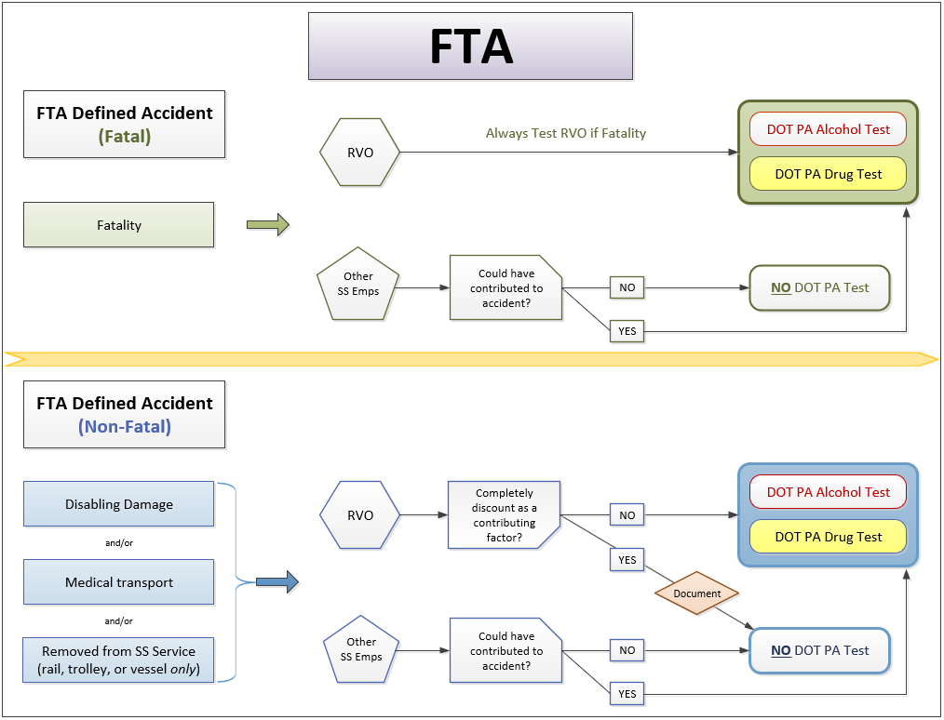

Slide 19
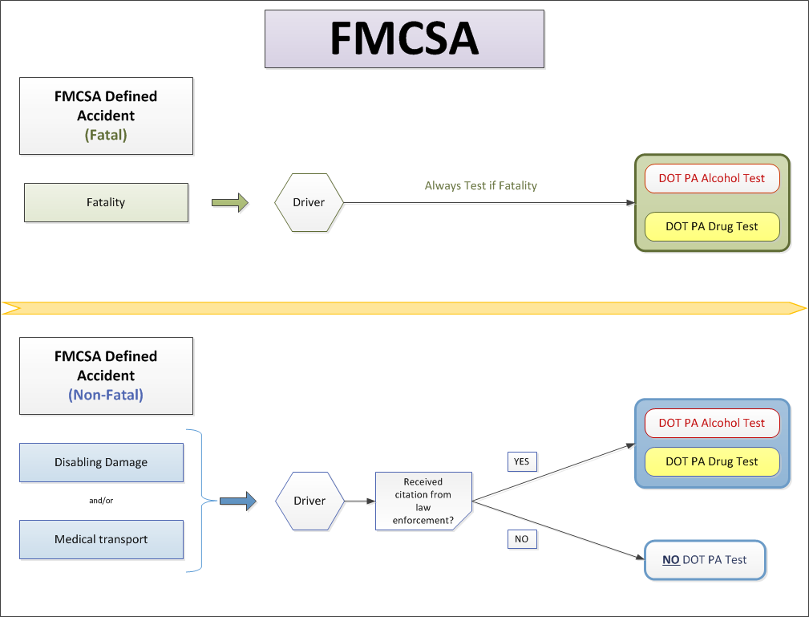

Slide 20
Post-Accident Time Requirements
FTA
FMCSA
As soon as practicable after SS employee dismissed from scene and medical attention provided
Same
Testing occurs once employer makes decision
Alcohol: 2 hr / 8 hr rule
Drugs: 32 hr rule
Testing occurs once citation is issued
Alcohol: 2 hr / 8 hr rule
Drugs: 32 hr rule

Slide 21
Key Questions – Post-Accident Testing
Do I send the employee for an FTA post-accident test or an FMCSA post-accident test?
Choose the mode that regulates the employee’s functions at the time of the accident.
Best Practice: Have a decision-making form that clearly walks supervisors through decision process and helps them understand when to FTA test, when to FMCSA test, and when no testing is required.

Slide 22
Reasonable Suspicion
FTA
FMCSA
Specific, contemporaneous, articulable observations concerning appearance, behavior, speech, or body odors of employee
Same
Observations may also include indications of chronic effects and withdrawal effects for drugs (but not alcohol)

Slide 23
Reasonable Suspicion
FTA
FMCSA
Alcohol tests just before, during, or just after performance of SS function
Same
Trained supervisor or company official must make observations
Same
No specified timeline for written reports (best practice is to be prompt)
Written report within 24 hours of observed behavior, or before test results are released if earlier than
24 hours

Slide 24
Key Questions – Reasonable Suspicion
Are the training requirements for supervisors the same?
Yes.
Note: The training does not need to be FTA- or FMCSA-specific.
What is checked on the CCF: FTA or FMCSA?
Choose the mode that regulates the employee’s functions at the time of the decision to test.

Slide 25
Alcohol Prohibitions
FTA
FMCSA
No performing SS function with alcohol concentration 0.04 or greater
Same
No alcohol use within 4 hours prior to performing SS function
Same
No use while on-call to perform a SS function
8 hrs off-duty after alcohol result 0.02-0.039, or until <0.02
24 hrs off-duty after alcohol result 0.02-0.039

Slide 26
Key Questions – Alcohol Prohibtions
After an alcohol result of 0.02-0.039, do I keep the employee out for 8 hours or 24 hours?
It depends on the modal authority of the test:
0.02-0.039 on an FTA test → out for at least 8 hours
0.02-0.039 on an FMCSA test → out for at least 24 hours

Slide 27
Consequences for Violations
FTA
FMCSA
Immediate removal from safety-sensitive function
Same
Referral to qualified Substance Abuse Professional
Same
Return-to-duty and Follow-up
(if applicable):
Performed in accordance with Part 40, Subpart O
Same

Slide 28
Key Questions – Violations
Are the return-to-duty requirements identical?
Yes, both follow the requirements in Part 40, Subpart O.

Slide 29
Rx and OTC Medications
FTA
FMCSA
No regulatory requirements, Rx/OTC policy recommended
Drivers cannot operate unless advised by licensed physician that the Rx will not impact ability to safely operate a CMV
Employers may require employees to disclose use of any Rx/OTC medications
Same

Slide 30
Policy Requirements
FTA
FMCSA
Develop policy statement
Same
Disseminate policy or written notice of availability to all covered employees
Disseminate policy to all covered employees
Written notice of policy availability to employee organizations
Same
Signed certificate of receipt recommended, but not required
Signed certificate of receipt required
Approval/adoption by local governing board or official with designated authority

Slide 31
Policy: Required Content
FTA
FMCSA
Identity of contact person designated to answer questions
Same
Categories of covered employees
Same
Covered safety-sensitive functions

Slide 32
Policy: Required Content
FTA
FMCSA
Testing circumstances
Same
Testing procedures in accordance with Part 40
Same
Requirement to submit for testing
Drugs (anytime on duty)
Alcohol (just before, during, or after SS function)
Same

Slide 33
Policy: Required Content
FTA
FMCSA
Prohibited behaviors
Same
Refusal behaviors
Same
Consequences of a positive drug test, alcohol test result of 0.04 or greater, or test refusal
Same
Consequences of an alcohol test result of 0.02-0.039
Same

Slide 34
Policy: Required Content
FTA
FMCSA
Any additional employer provisions
Clearly differentiated
Same
Info about effects, signs, and symptoms of drug and alcohol use, methods of intervention
Info required to be reported to the Clearinghouse (on and after January 6, 2020)

Slide 35
Key Questions – Policies
Do I need two separate policies?
No, you can incorporate the required provisions from both modes into one policy
Sample policy is available at:
http://transit-safety.fta.dot.gov/DrugAndAlcohol/Tools/

Slide 36
Employee & Supervisor Training
FTA
FMCSA
Safety-sensitive employees:
60 min of training on effects and consequences of prohibited drug use
Safety-sensitive employees:
Info on effects and consequences of drug use and alcohol use provided in policy
Reasonable suspicion for supervisors:
60 min - indicators of drug use
60 min - indicators of alcohol misuse
Same

Slide 37
Records Retention - Training
FTA
FMCSA
Records related to training of supervisors & employees:
Retain for at least 2 years
Records related to training of supervisors, drivers, BATs, STTs:
Retain for at least 2 years after the person has ceased performing these functions
For an easy-to-use table of other records
retention requirements for all DOT modes,
see ODAPC’s Employer Guidelines

Slide 38
MIS Reporting
FTA
FMCSA
Annually prepare and maintain a summary of test results
Same
Submit to FTA by March 15
Submit to FMCSA, only when requested, by March 15

Slide 39
Key Questions – MIS Reporting
How do I report?
Report covered employees to the mode regulating >50% of the employee’s functions.
Report testing information to the mode under which the tests were conducted.
Do not double report.
What if all employees work majority for FMCSA… do I report anything to FTA?
Report zero employees to FTA, but indicate any tests conducted under FTA authority.

Slide 40
Enforcement & Compliance
FTA
FMCSA
Suspension or ineligibility for FTA funding
Fines and penalties on the employer and/or employee
Must certify compliance annually
State DOTs certify compliance of sub-recipients
No requirement to certify compliance, except “New Entrant” employers

Slide 41
Helpful Contact Information
What if I have questions?
FTA Assistance:
Iyon Rosario
(202)366-2010 or iyon.rosario@dot.gov
FTA Drug and Alcohol Hotline
(617)494-6336 or fta.damis@dot.gov
FMCSA Assistance:
Juan Moya
(202)366-4844 or juan.moya@dot.gov
FMCSA Drug and Alcohol
(202)366-2096 or fmcsadrugandalcohol@dot.gov

